Slide 1
Listening to maps
René Rubalcava
SoftWhere Dev @ esri
@odoenet
HalfStack NY, Aug 2019

Slide 2
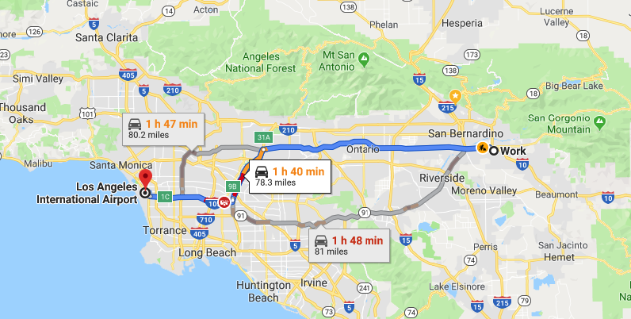
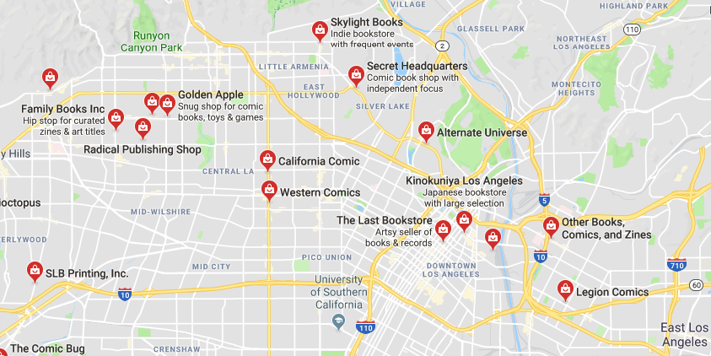
How do we use maps?
Every day maps
Directions
Comic book stores
Store hours
Store web sites
Maps can tell you so much more…

Slide 3
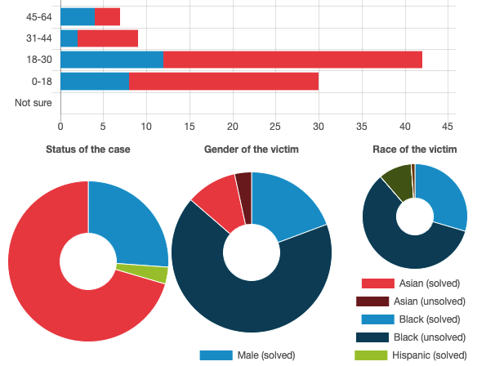
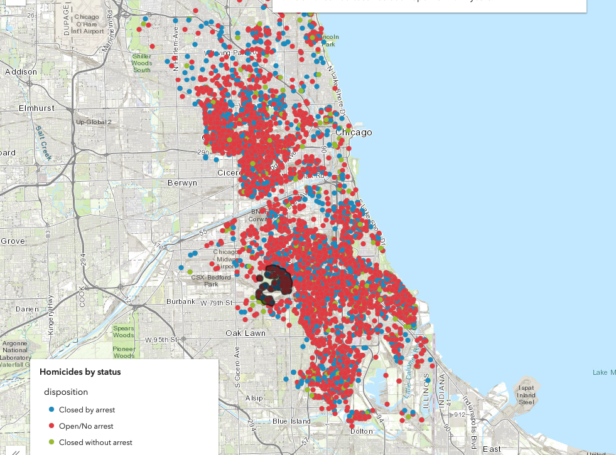
Meaning
Maps to visualize data
Beyond points on map
What does these points actually mean?
https://developers.arcgis.com/javascript/latest/sample-code/featurelayerview-query-distance/live/index.html

Slide 4
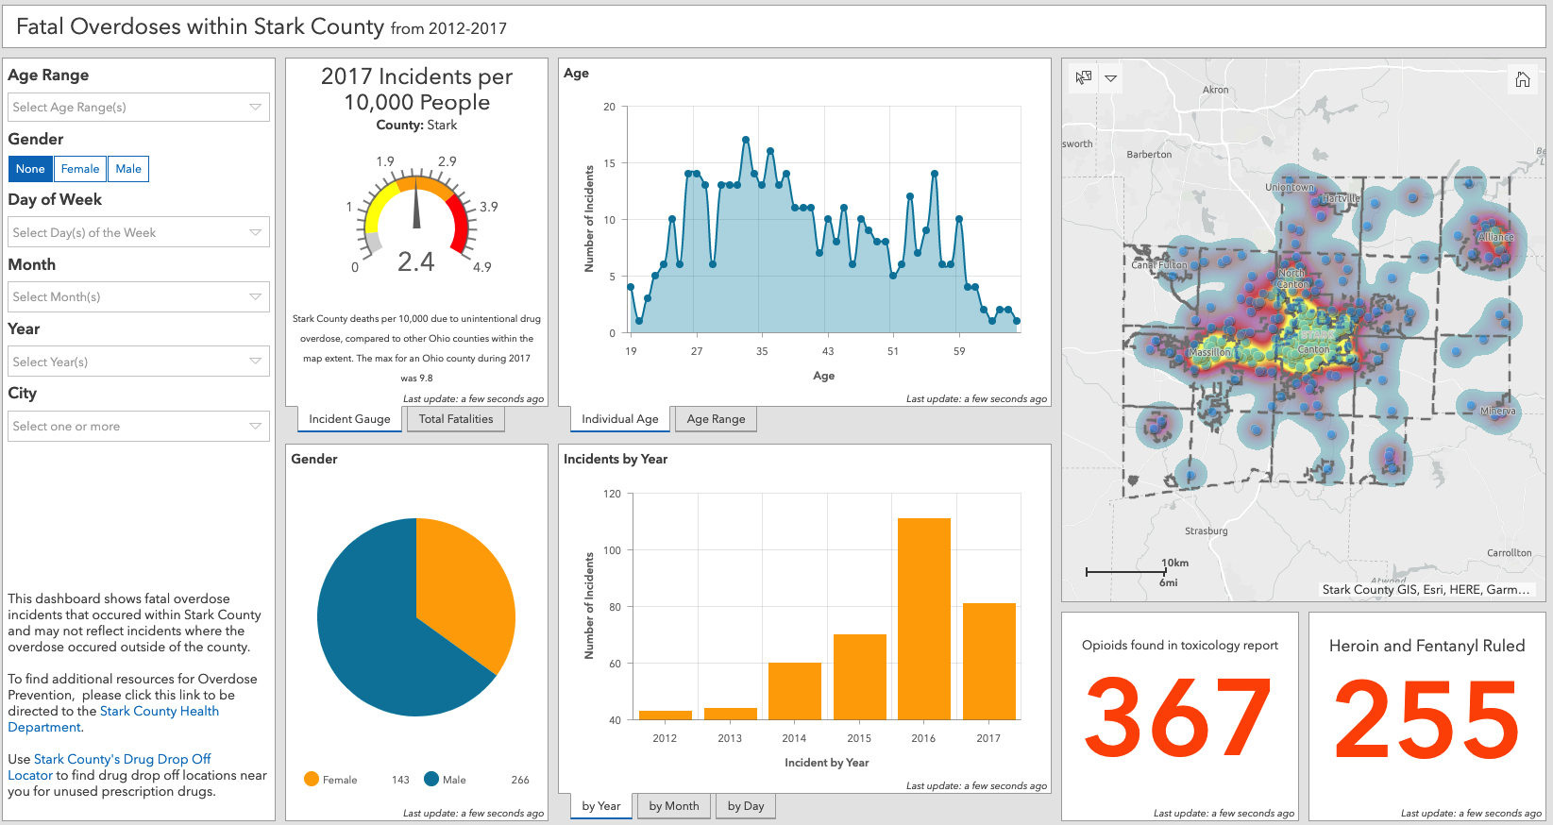
Data reporting
https://starkcountyohio.maps.arcgis.com/apps/opsdashboard/index.html#/568a71ea5f5845dfb8b135dbe5d46534

Slide 5
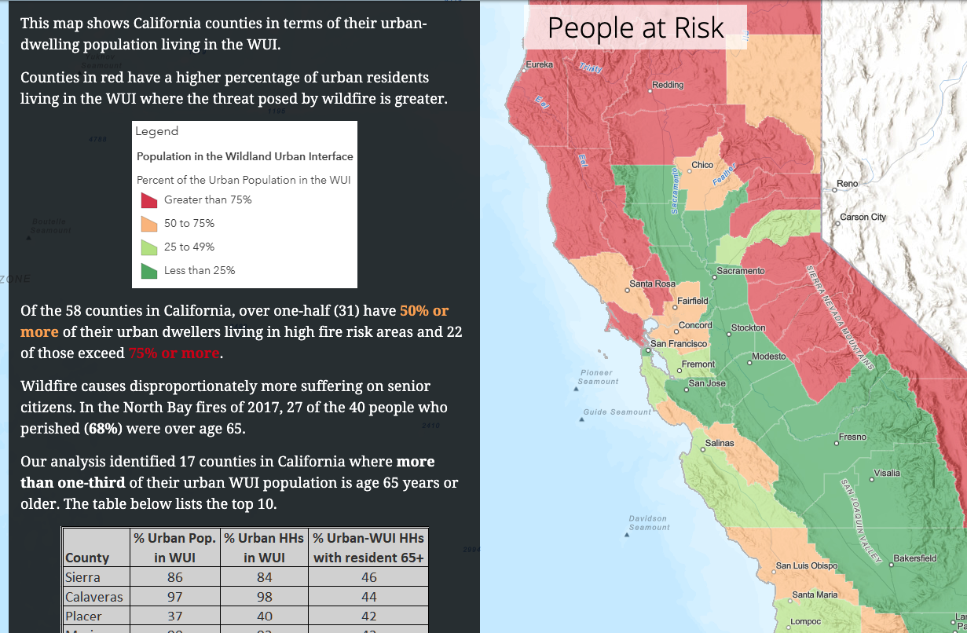
Story telling
Maps can tell a story
Data driven
A new look at the world
https://landscapeteam.maps.arcgis.com/apps/Cascade/index.html?appid=cd69320c00384d8094d83b45e84fd5aa

Slide 6
Just nod if you can hear me
Web Audio API - https://developer.mozilla.org/en-US/docs/Web/API/Web_Audio_API
Questions to ask
How can I listen to the story of a map?
Can I even do this?
Why would I do this?
What was I thinking?

Slide 7
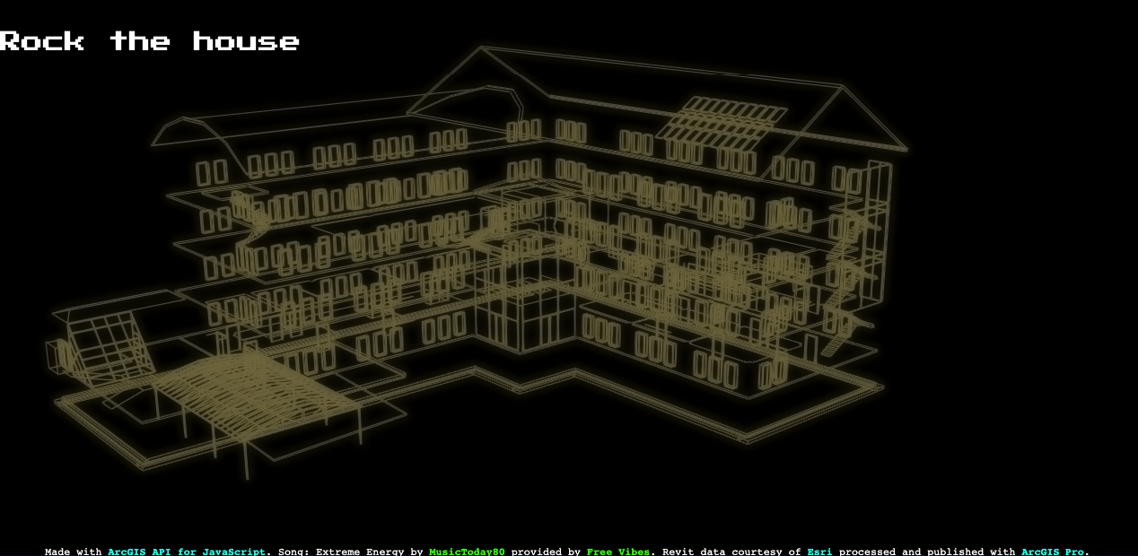
Rock the house
https://ralucanicola.github.io/JSAPI_demos/rock-the-house/

Slide 8
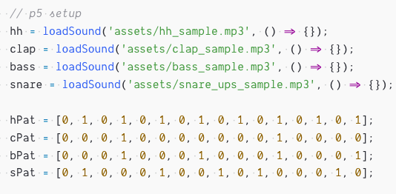
I’m lazy
p5.js
https://p5js.org/
Processing library with an audio module
ArcGIS API for JavaScript
https://js.arcgis.com
Mapping Library (I work on this team!)

Slide 9
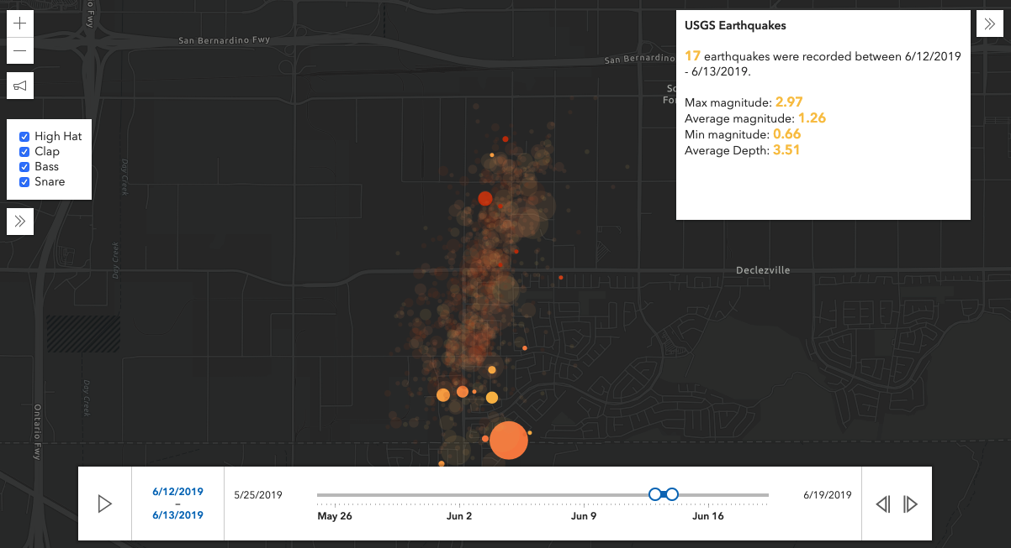
Earthquake time
Earthquakes in area over a period of time
Look at data in time slices
Statistics of data drive audio
Delay – echo effect driven by stats
BPM – beats per minute driven by count
https://go.esri.com/audio-time

Slide 10
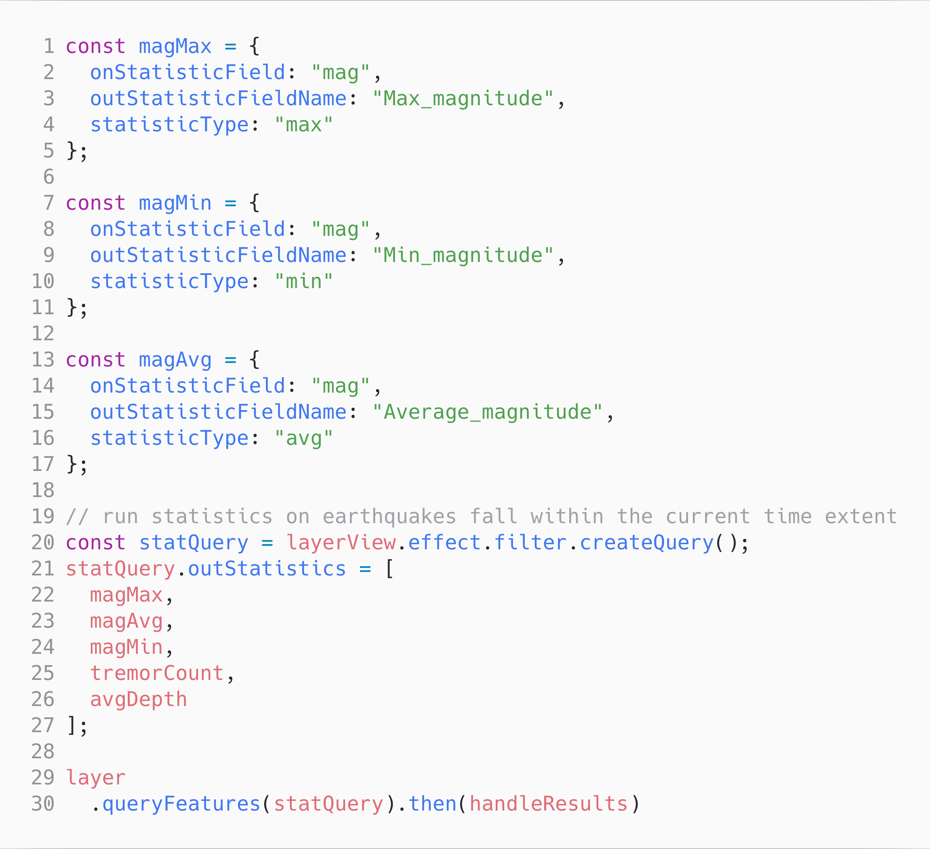
Earthquake time
https://go.esri.com/audio-time

Slide 11
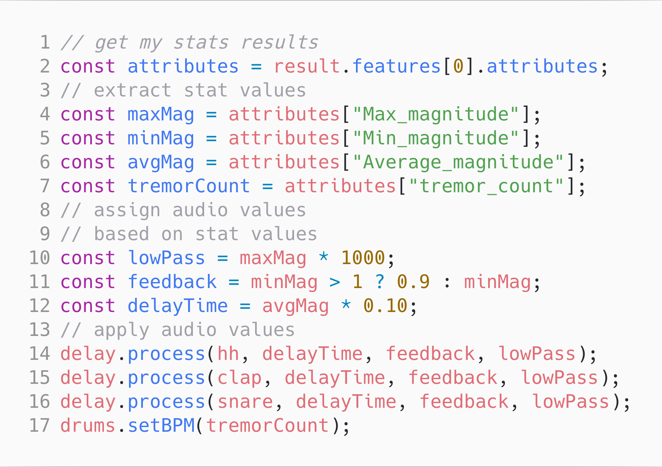
Earthquake time
https://go.esri.com/audio-time

Slide 12
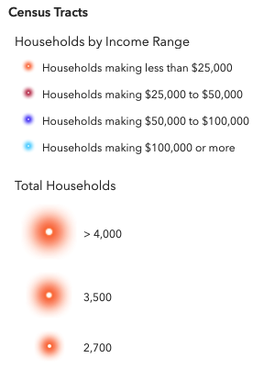
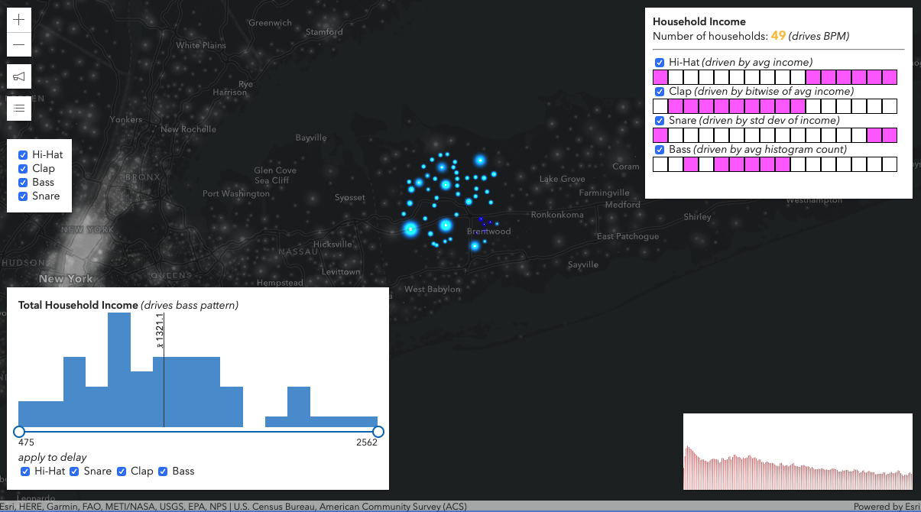
Voice of income
https://go.esri.com/audio-stats

Slide 13
Voice of income
Update Sequence
Above or below the average
16 fields to 16 steps in a sequence
Avg Value of field:
Below = 0
Above = 1
[0,0,0,1,0,0,0,1,0,0,0,1,0,0,0,1]
https://go.esri.com/audio-stats

Slide 14
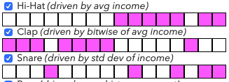
Voice of income
Hi-hat (above or below avg income)
Clap (fill in gaps)
Snare (above or below avg std dev of income)
https://go.esri.com/audio-stats

Slide 15
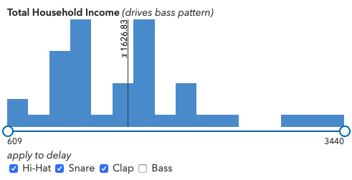
Voice of income
Bass Sequence
Avg Count in bins
Above (1)
Below (0)
https://go.esri.com/audio-stats

Slide 16
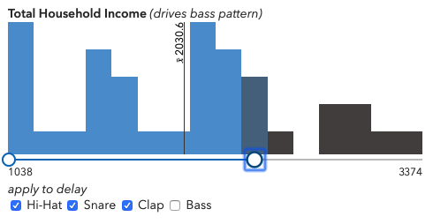
Voice of income
Audio Delay
https://go.esri.com/audio-stats
% of values in range
applied to delay

Slide 17
Summary
Completely experimental
Has given me ideas!
Potential accessibility enhancements
I can realize my dream of becoming a DJ
Get rich on SoundCloud

Slide 18
Thank you
@odoenet
https://odoe.net/
https://careers .esri.com

